Slide 1

Genetic Algorithm for finding the maximum of a given function
09015113 Qiaofeng Liu

Slide 2

Problem Description
Find the maximum of function$f\left(x\right)=x+10\sin\left(5x\right)+7cos⁡(4x)$ within the range [0, 9].
Use Genetic Algorithm to solve this problem.

Slide 3
Terms
Population: candidate solutions
Individual: a solution, component of Population
Chromosome (or Genotype): property of Individual, which can be mutated and altered
Fitness function: a measurement of the solutions

Slide 4

Representation
Segment the range into ($2^{Number of genes}$ - 1) segments.
Each individual is viewed as a binary number B, and it could be converted to a decimal number D.
The $x$ value is calculated by
$$x=D\frac{\left(upper −lower\right)}{2^{Number of genes} − 1 }$$

Slide 5
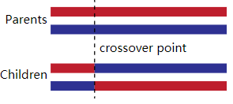
Single-point Crossover
Randomize a position P for single-point crossover.
SON: Genes in positions 0~P are assigned as the FATHER’s, the genes in remaining positions are assigned as the MOTHER’s.
DAUGHTER: Genes in positions 0~P are assigned as the MOTHER’s, the genes in remaining positions are assigned as the FATHER’s.

Slide 6
Mutation
1. The number of individuals to be mutated N is equal to the mutation rate multiplying the volume of the population.
2. Repeat for N times:
(1) During each loop, a candidate is selected.
(2) Randomize a position in the individual to be mutated and flip it.

Slide 7

Selection and clipping
The probability of the $i^{th}$ individual in the population following Roulette Selection. ( $p_{i}=\frac{f(i)}{\sum_{j=1}^{N}{f(j)}}$)
The fitness value could be negative, so during each selection process, the minimum fitness value MIN of the population is found, and each fitness value subtracts (MIN – 1).
The number of individuals remaining is equal to the original volume (or size) of the population.

Slide 8
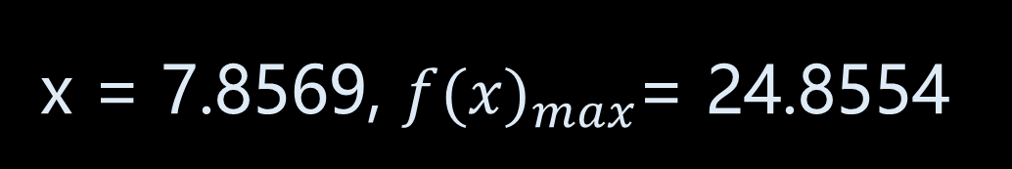
Experiment Result
x = 7.8569, ${f(x)}_{max}$= 24.8554

Slide 9
Experiment Result
The speed of convergence is highly correlated to the volume (or size) of the population (the larger, the faster).
The method is not guaranteed to find the maximum, namely, it may be trapped in some local maxima.
The rate of mutation should not be too high (around 0.1 – 0.3).

Slide 10
Reference
https://stackoverflow.com/questions/9401658/how-to-animate-a-scatter-plot
https://en.wikipedia.org/wiki/Genetic_algorithm
Machine Learning written by Tom Mitchell

Slide 11

Thanks for watching!

